Slide 1
JQUERY and Introduction to Angular JS
Dr. Roshan D Suvaris
Asst. Professor
MCA Department

Slide 2
JQUERY
Introduction,
Syntax,
selectors,
events,
JQuery HTML,
Effects

Slide 3
Introduction
The purpose of jQuery is to make it much easier to use JavaScript on your website.
jQuery is a lightweight, "write less, do more", JavaScript library.
The purpose of jQuery is to make it much easier to use JavaScript on your website.
jQuery takes a lot of common tasks that require many lines of JavaScript code to accomplish, and wraps them into methods that you can call with a single line of code.
jQuery also simplifies a lot of the complicated things from JavaScript, like AJAX calls and DOM manipulation.
There are lots of other JavaScript libraries out there, but jQuery is probably the most popular, and also the most extendable.

Slide 4
Adding jQuery to Your Web Pages
There are several ways to start using jQuery on your web site. You can:
Download the jQuery library from jQuery.com
Production version - this is for your live website because it has been minified and compressed
Development version - this is for testing and development (uncompressed and readable code)
The jQuery library is a single JavaScript file, and you reference it with the HTML <script> tag (notice that the <script> tag should be inside the <head> section):
<head> <script src="jquery-3.7.1.min.js"></script> </head>
Include jQuery from a CDN, like Google
If you don't want to download and host jQuery yourself, you can include it from a CDN
<head> <script src="https://ajax.googleapis.com/ajax/libs/jquery/3.7.1/jquery.min.js"></script> </head>

Slide 5
jQuery Syntax
The jQuery syntax is made for selecting HTML elements and performing some action on the element(s).
Basic syntax is: $(selector).action()
A $ sign to define/access jQuery
A (selector) to "query (or find)" HTML elements
A jQuery action() to be performed on the element(s)
Examples:
$(this).hide() - hides the current element.
$("p").hide() - hides all <p> elements. //CSS selectors
$(".test").hide() - hides all elements with class="test". //CSS selectors
$("#test").hide() - hides the element with id="test". //CSS selectors

Slide 6
Continued…
The Document Ready Event – jQuery methods are written inside document ready event
$(document).ready(function(){
// jQuery methods go here...
});
This is to prevent any jQuery code from running before the document is finished loading (is ready).
It is good practice to wait for the document to be fully loaded and ready before working with it.
This also allows you to have your JavaScript code before the body of your document, in the head section.
Shorter method for document ready event:
$(function(){
// jQuery methods go here...
});

Slide 7
jQuery Selectors
jQuery selectors allow you to select and manipulate HTML element(s).
jQuery selectors are used to "find" (or select) HTML elements based on their name, id, classes, types, attributes, values of attributes and much more.
It's based on the existing CSS Selectors, and in addition, it has some own custom selectors.
All selectors in jQuery start with the dollar sign and parentheses: $().
The element Selector
The jQuery element selector selects elements based on the element name.
You can select all <p> elements on a page like this: $("p")
$(document).ready(function(){
$("button").click(function(){
$("p").hide();
});
});

Slide 8
The #id Selector
The jQuery #id selector uses the id attribute of an HTML tag to find the specific element.
An id should be unique within a page, so you should use the #id selector when you want to find a single, unique element.
To find an element with a specific id, write a hash character, followed by the id of the HTML element: $("#test")
$(document).ready(function(){
$("button").click(function(){
$("#test").hide();
});
});

Slide 9
The .class Selector
The jQuery .class selector finds elements with a specific class.
To find elements with a specific class, write a period character, followed by the name of the class: $(".test")
$(document).ready(function(){
$("button").click(function(){
$(".test").hide();
});
});

Slide 10
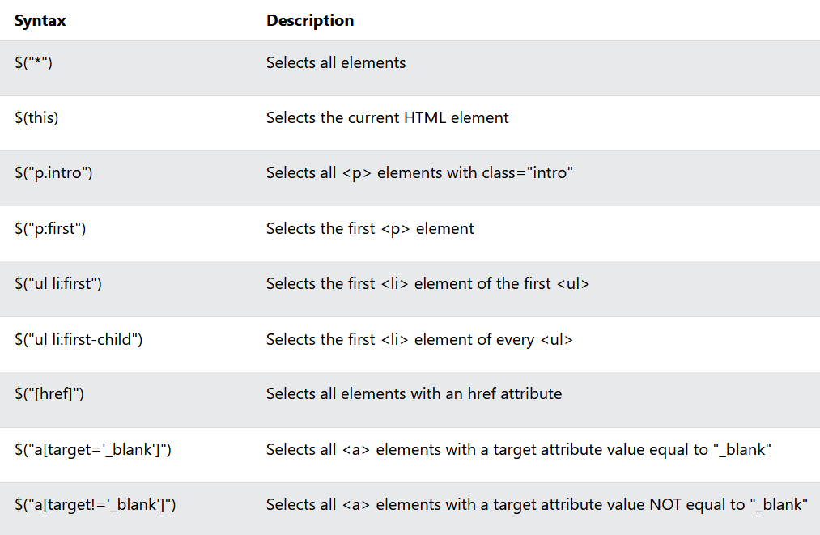
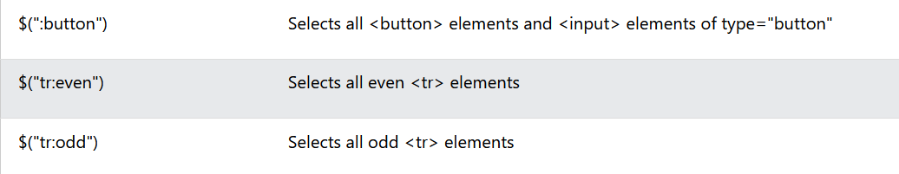
More Examples of jQuery Selectors

Slide 11
Functions In a Separate File
If your website contains a lot of pages, and you want your jQuery functions to be easy to maintain, you can put your jQuery functions in a separate .js file.
Sometimes it is preferable to place them in a separate file, like this (use the src attribute to refer to the .js file):
<head> <script src="https://ajax.googleapis.com/ajax/libs/jquery/3.7.1/jquery.min.js"></script> <script src="my_jquery_functions.js"></script> </head>

Slide 12
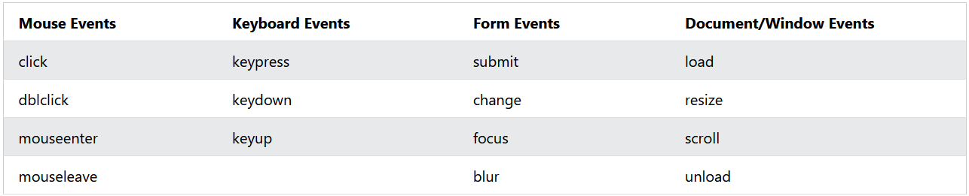
jQuery Event Methods
All the different visitors' actions that a web page can respond to are called events.
An event represents the precise moment when something happens.
Here are some common DOM events:

Slide 13
jQuery Syntax For Event Methods
In jQuery, most DOM events have an equivalent jQuery method.
To assign a click event to all paragraphs on a page, you can do this:
$("p").click();
The next step is to define what should happen when the event fires. You must pass a function to the event:
$("p").click(function(){
//actiongoeshere!!
});

Slide 14
Commonly Used jQuery Event Methods
$(document).ready()
The $(document).ready() method allows us to execute a function when the document is fully loaded.
click()
The click() method attaches an event handler function to an HTML element.
The function is executed when the user clicks on the HTML element.
$("p").click(function(){
$(this).hide();
});
dblclick()
The dblclick() method attaches an event handler function to an HTML element.
$("p").dblclick(function(){
$(this).hide();
});

Slide 15
Continued…
mouseenter()
The mouseenter() method attaches an event handler function to an HTML element.
$("#p1").mouseenter(function(){
alert("You entered p1!");
});
mouseleave()
The mouseleave() method attaches an event handler function to an HTML element.
$("#p1").mouseleave(function(){
alert("Bye! You now leave p1!");
});

Slide 16
Continued…
mousedown()
The mousedown() method attaches an event handler function to an HTML element.
The function is executed, when the left, middle or right mouse button is pressed down, while the mouse is over the HTML element:
$("#p1").mousedown(function(){ alert("Mouse down over p1!"); });
mouseup()
The mouseup() method attaches an event handler function to an HTML element.
$("#p1").mouseup(function(){ alert("Mouse up over p1!"); });

Slide 17
Continued…
hover()
The hover() method takes two functions and is a combination of the mouseenter() and mouseleave() methods.
The first function is executed when the mouse enters the HTML element, and the second function is executed when the mouse leaves the HTML element:
$("#p1").hover(function(){
alert("You entered p1!");
},
function(){
alert("Bye! You now leave p1!");
});
focus()
The focus() method attaches an event handler function to an HTML form field.
The function is executed when the form field gets focus:
$("input").focus(function(){ $(this).css("background-color", "#cccccc"); });

Slide 18
blur()
The blur() method attaches an event handler function to an HTML form field.
The function is executed when the form field loses focus:
$("input").blur(function(){ $(this).css("background-color", "#ffffff"); });
The on() Method
The on() method attaches one or more event handlers for the selected elements.
$("p").on("click",function(){
$(this).hide();
});
Attach multiple event handlers to a <p> element:
$("p").on({
mouseenter:function(){
$(this).css("background-color","lightgray");
},
mouseleave:function(){
$(this).css("background-color","lightblue");
},
click:function(){
$(this).css("background-color","yellow");
}
});

Slide 19
jQuery Effects
Hide, Show, Toggle, Slide, Fade, and Animate.
jQuery hide() and show()
With jQuery, you can hide and show HTML elements with the hide() and show() methods.
Syntax:
$(selector).hide(speed,callback);
$(selector).show(speed,callback);
The optional speed parameter specifies the speed of the hiding/showing, and can take the following values: "slow", "fast", or milliseconds.
The optional callback parameter is a function to be executed after the hide() or show() method completes.
jQuery toggle()
You can also toggle between hiding and showing an element with the toggle() method.
$(selector).toggle(speed,callback);

Slide 20
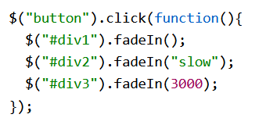
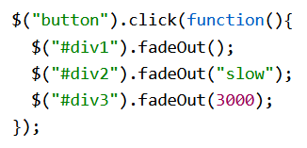
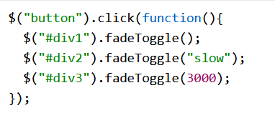
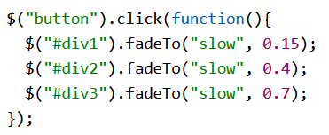
jQuery Effects - Fading
jQuery Fading Methods
With jQuery you can fade an element in and out of visibility
jQuery has the following fade methods:
fadeIn()
fadeOut()
fadeToggle()
fadeTo()
$(selector).fadeIn(speed,callback);

Slide 21
jQuery Effects - Sliding
With jQuery you can create a sliding effect on elements.
jQuery has the following slide methods:
slideDown()
slideUp()
slideToggle()
jQuery slideDown() Method
The jQuery slideDown() method is used to slide down an element.
Syntax: $(selector).slideDown(speed,callback);
$("#flip").click(function(){ $("#panel").slideDown(); });
jQuery slideUp() Method
The jQuery slideUp() method is used to slide up an element.
Syntax: (selector).slideUp(speed,callback);

Slide 22
Continued…
jQuery slideToggle() Method
The jQuery slideToggle() method toggles between the slideDown() and slideUp() methods.
If the elements have been slid down, slideToggle() will slide them up.
If the elements have been slid up, slideToggle() will slide them down.
$(selector).slideToggle(speed,callback);
$("#flip").click(function(){
$("#panel").slideToggle();
});

Slide 23
jQuery Effects - Animation
The jQuery animate() method is used to create custom animations.
Syntax: $(selector).animate({params},speed,callback);
The required params parameter defines the CSS properties to be animated.
$("button").click(function(){
$("div").animate({
left:'250px’,
opacity:'0.5’,
height:'150px’,
width:'150px’
});
});
jQuery animate() - Using Pre-defined Values
You can even specify a property's animation value as "show", "hide", or "toggle":
$("button").click(function(){ $("div").animate({ height: 'toggle' }); });

Slide 24
Continued…
jQuery animate() - Uses Queue Functionality
By default, jQuery comes with queue functionality for animations.
This means that if you write multiple animate() calls after each other, jQuery creates an "internal" queue with these method calls. Then it runs the animate calls ONE by ONE.
$("button").click(function(){
var div = $("div");
div.animate({height: '300px', opacity: '0.4'}, "slow");
div.animate({width: '300px', opacity: '0.8'}, "slow");
div.animate({height: '100px', opacity: '0.4'}, "slow");
div.animate({width: '100px', opacity: '0.8'}, "slow");
});

Slide 25
jQuery Stop Animations
The jQuery stop() method is used to stop animations or effects before it is finished.
The stop() method works for all jQuery effect functions, including sliding, fading and custom animations.
Syntax: $(selector).stop(stopAll,goToEnd);
The optional stopAll parameter specifies whether also the animation queue should be cleared or not. Default is false, which means that only the active animation will be stopped, allowing any queued animations to be performed afterwards.
The optional goToEnd parameter specifies whether or not to complete the current animation immediately. Default is false.
$(document).ready(function(){
$("#flip").click(function(){
$("#panel").slideDown(5000);
});
$("#stop").click(function(){
$("#panel").stop();
});
});

Slide 26
jQuery Callback Functions
JavaScript statements are executed line by line. However, with effects, the next line of code can be run even though the effect is not finished. This can create errors.
To prevent this, you can create a callback function.
A callback function is executed after the current effect is finished.
Examples
The example below has a callback parameter that is a function that will be executed after the hide effect is completed:
$("button").click(function(){
$("p").hide("slow", function(){
alert("The paragraph is now hidden");
});
});

Slide 27
Continued…
The example below has no callback parameter, and the alert box will be displayed before the hide effect is completed:
$("button").click(function(){
$("p").hide(1000);
alert("The paragraph is now hidden");
});

Slide 28
jQuery - Chaining
With jQuery, you can chain together actions/methods.
Chaining allows us to run multiple jQuery methods (on the same element) within a single statement.
To chain an action, you simply append the action to the previous action.
The following example chains together the css(), slideUp(), and slideDown() methods. The "p1" element first changes to red, then it slides up, and then it slides down
$("#p1").css("color", "red").slideUp(2000).slideDown(2000);

Slide 29
jQuery - Get Content and Attributes
jQuery contains powerful methods for changing and manipulating HTML elements and attributes.
One very important part of jQuery is the possibility to manipulate the DOM.
jQuery comes with a bunch of DOM related methods that make it easy to access and manipulate elements and attributes.
Three simple, but useful, jQuery methods for DOM manipulation are:
text() - Sets or returns the text content of selected elements
html() - Sets or returns the content of selected elements (including HTML markup)
val() - Sets or returns the value of form fields
$("#btn1").click(function(){
alert("Text: " + $("#test").text()); //returns the text written inside paragraph tag
});
$("#btn2").click(function(){
alert("HTML: " + $("#test").html()); //Returns the html tags inside paragraph
});
$("#btn1").click(function(){
alert("Value: " + $("#test").val()); //Returns value of the input filed.
});

Slide 30
Get Attributes - attr()
The jQuery attr() method is used to get attribute values.
The following example demonstrates how to get the value of the href attribute in a link:
$("button").click(function(){
alert($("#w3s").attr("href"));
});

Slide 31
jQuery - Set Content and Attributes
We will use the same three methods from the previous page to set content:
text() - Sets or returns the text content of selected elements
html() - Sets or returns the content of selected elements (including HTML markup)
val() - Sets or returns the value of form fields
$("#btn1").click(function(){
$("#test1").text("Hello world!");
});
$("#btn2").click(function(){
$("#test2").html("<b>Hello world!</b>");
});
$("#btn3").click(function(){
$("#test3").val("Dolly Duck");
});

Slide 32
A Callback Function for text(), html(), and val()
All of the three jQuery methods above: text(), html(), and val(), also come with a callback function.
The callback function has two parameters: the index of the current element in the list of elements selected and the original (old) value. You then return the string you wish to use as the new value from the function.
$("#btn1").click(function(){
$("#test1").text(function(i, origText){
return "Old text: " + origText + " New text: Hello world!(index: " + i + ")";
});
});
$("#btn2").click(function(){
$("#test2").html(function(i, origText){
return "Old html: " + origText + " New html: Hello <b>world!</b>(index: " + i + ")";
});
});

Slide 33
Set Attributes - attr()
The jQuery attr() method is also used to set/change attribute values.
The following example demonstrates how to change (set) the value of the href attribute in a link:
$("button").click(function(){
$("#w3s").attr("href", "https://www.google.com/");
});
The attr() method also allows you to set multiple attributes at the same time.

Slide 34
jQuery - Add Elements
We will look at four jQuery methods that are used to add new content:
append() - Inserts content at the end of the selected elements
prepend() - Inserts content at the beginning of the selected elements
after() - Inserts content after the selected elements
before() - Inserts content before the selected elements
jQuery append() Method
The jQuery append() method inserts content AT THE END of the selected HTML elements.
$("p").append("Some appended text.");
jQuery prepend() Method
The jQuery prepend() method inserts content AT THE BEGINNING of the selected HTML elements.
$("p").prepend("Some prepended text.");

Slide 35
Continued…
both the append() and prepend() methods can take an infinite number of new elements as parameters.
The new elements can be generated with text/HTML, with jQuery, or with JavaScript code and DOM elements.
function appendText() {
var txt1 = "<p>Text.</p>"; // Create element with HTML
var txt2 = $("<p></p>").text("Text."); // Create with jQuery
var txt3 = document.createElement("p"); // Create with DOM
txt3.innerHTML = "Text.";
$("body").append(txt1, txt2, txt3); // Append the new elements
}

Slide 36
jQuery after() and before() Methods
The jQuery after() method inserts content AFTER the selected HTML elements.
The jQuery before() method inserts content BEFORE the selected HTML elements.
$("img").after("Some text after");
$("img").before("Some text before");
both the after() and before() methods can take an infinite number of new elements as parameters.
The new elements can be generated with text/HTML, with jQuery, or with JavaScript code and DOM elements.

Slide 37
jQuery - Remove Elements
Remove Elements/Content
To remove elements and content, there are mainly two jQuery methods:
remove() - Removes the selected element (and its child elements)
empty() - Removes the child elements from the selected element
jQuery remove() Method
The jQuery remove() method removes the selected element(s) and its child elements.
$("#div1").remove();
jQuery empty() Method
The jQuery empty() method removes the child elements of the selected element(s).
$("#div1").empty();
Filter the Elements to be Removed
The jQuery remove() method also accepts one parameter, which allows you to filter the elements to be removed.
The parameter can be any of the jQuery selector syntaxes.
$("p").remove(".test");

Slide 38
jQuery - Get and Set CSS Classes
jQuery has several methods for CSS manipulation. We will look at the following methods:
addClass() - Adds one or more classes to the selected elements
removeClass() - Removes one or more classes from the selected elements
toggleClass() - Toggles between adding/removing classes from the selected elements
css() - Sets or returns the style attribute

Slide 39
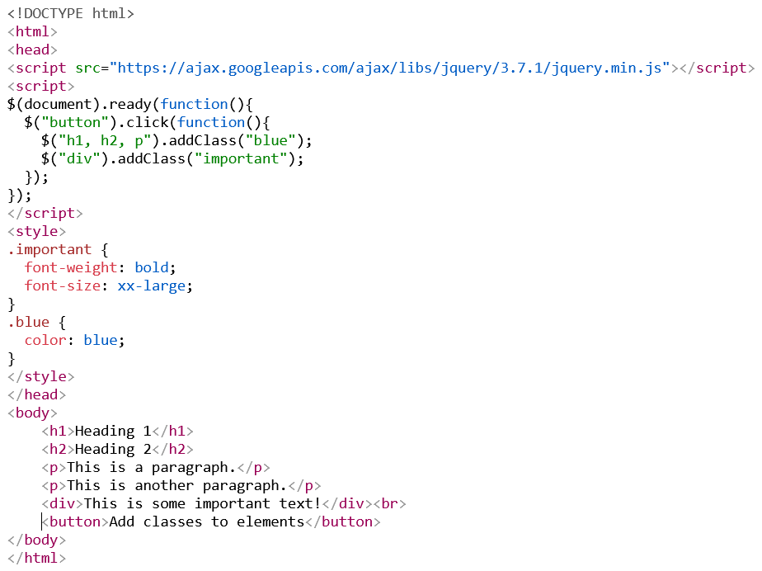
Title
Content

Slide 40
jQuery addClass() Method
The following example shows how to add class attributes to different elements. Of course you can select multiple elements, when adding classes
$("button").click(function(){
$("h1, h2, p").addClass("blue");
$("div").addClass("important");
});
jQuery removeClass() Method
remove a specific class attribute from different elements
$("button").click(function(){
$("h1, h2, p").removeClass("blue");
});
jQuery toggleClass() Method - adding/removing classes from the selected elements
$("button").click(function(){
$("h1, h2, p").toggleClass("blue");
});

Slide 41
jQuery css() Method
The css() method sets or returns one or more style properties for the selected elements.
Return a CSS Property - To return the value of a specified CSS property
$("p").css("background-color");
Set a CSS Property
$("p").css("background-color", "yellow");
Set Multiple CSS Properties
$("p").css({"background-color": "yellow", "font-size": "200%"});

Slide 42
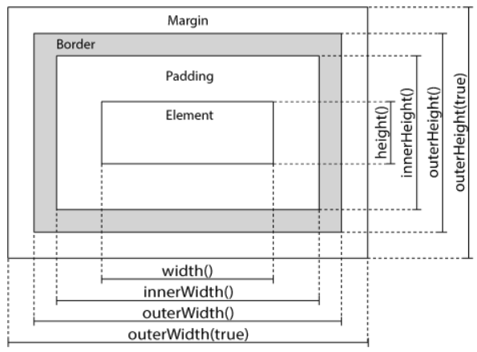
jQuery - Dimensions
jQuery has several important methods for working with dimensions:
width()
height()
innerWidth()
innerHeight()
outerWidth()
outerHeight()

Slide 43
jQuery width() and height() Methods
The width() method sets or returns the width of an element (excludes padding, border and margin).
The height() method sets or returns the height of an element (excludes padding, border and margin).
//get width and height of div element
$("button").click(function(){
var txt = "";
txt += "Width: " + $("#div1").width() + "</br>";
txt += "Height: " + $("#div1").height();
$("#div1").html(txt);
});

Slide 44
Continued…
jQuery innerWidth() and innerHeight() Methods
The innerWidth() method returns the width of an element (includes padding).
The innerHeight() method returns the height of an element (includes padding).
jQuery outerWidth() and outerHeight() Methods
The outerWidth() method returns the width of an element (includes padding and border).
The outerHeight() method returns the height of an element (includes padding and border).

Slide 45
jQuery More width() and height()
The following example returns the width and height of the document (the HTML document) and window (the browser viewport)
$("button").click(function(){
var txt = "";
txt += "Document width/height: " + $(document).width();
txt += "x" + $(document).height() + "\n";
txt += "Window width/height: " + $(window).width();
txt += "x" + $(window).height();
alert(txt);
});
The following example sets the width and height of a specified <div> element:
$("button").click(function(){
$("#div1").width(500).height(500);
});

Slide 46
Contents:
What is AngularJS?
Angular Directives,
AngularJS Expression,
Angular Expression,
AngularJS Module,
AngularJS Controller,
AngularJS Filter.

Slide 47
AngularJS Introduction
AngularJS is a JavaScript framework.
AngularJS is a JavaScript framework written in JavaScript.
AngularJS is distributed as a JavaScript file.
It can be added to a web page with a script tag
<script src="https://ajax.googleapis.com/ajax/libs/angularjs/1.6.9/angular.min.js"></script>
AngularJS extends HTML attributes with Directives, and binds data to HTML with Expressions.
AngularJS extends HTML with ng-directives.
The ng-app directive defines an AngularJS application.
The ng-model directive binds the value of HTML controls (input, select, textarea) to application data.
The ng-bind directive binds application data to the HTML view.

Slide 48
Example:
<!DOCTYPE html>
<html>
<script src="https://ajax.googleapis.com/ajax/libs/angularjs/1.6.9/angular.min.js"></script>
<body>
<div ng-app="">
<p>Input something in the input box:</p>
<p>Name: <input type="text" ng-model="name"></p>
<p ng-bind="name"></p>
</div>
</body>
</html>
AngularJS starts automatically when the web page has loaded.
The ng-app directive tells AngularJS that the <div> element is the "owner" of an AngularJS application.
The ng-model directive binds the value of the input field to the application variable name.
The ng-bind directive binds the content of the <p> element to the application variable name.

Slide 49
Continued…
AngularJS Directives
AngularJS directives are HTML attributes with an ng prefix.
The ng-init directive initializes AngularJS application variables.
<div ng-app="" ng-init="firstName='John'"> <p>The name is <span ng-bind="firstName"></span></p> </div>
You can use data-ng-, instead of ng-, if you want to make your page HTML valid.
AngularJS Expressions
AngularJS expressions are written inside double braces: {{ expression }}.
AngularJS will "output" data exactly where the expression is written:
<div ng-app="">
<p>My first expression: {{ 5 + 5 }}</p>
</div>

Slide 50
Continued…
AngularJS expressions bind AngularJS data to HTML the same way as the ng-bind directive.
<div ng-app="">
<p>Name: <input type="text" ng-model="name"></p>
<p>{{name}}</p>
</div>
AngularJS Applications
AngularJS modules define AngularJS applications.
AngularJS controllers control AngularJS applications.
The ng-app directive defines the application, the ng-controller directive defines the controller.
<div ng-app="myApp" ng-controller="myCtrl"> First Name: <input type="text" ng-model="firstName"><br> Last Name: <input type="text" ng-model="lastName"><br><br> Full Name: {{firstName + " " + lastName}} </div> <script> var app = angular.module('myApp', []); app.controller('myCtrl', function($scope) { $scope.firstName= "John"; $scope.lastName= "Doe"; }); </script>

Slide 51
AngularJS Expressions
AngularJS binds data to HTML using Expressions.
AngularJS expressions can be written inside double braces: {{ expression }}.
AngularJS expressions can also be written inside a directive: ng-bind="expression".
AngularJS will resolve the expression, and return the result exactly where the expression is written.
AngularJS expressions are much like JavaScript expressions: They can contain literals, operators, and variables.
Example {{ 5 + 5 }} or {{ firstName + " " + lastName }}
Example to change the color of textbox using css property
<div ng-app="" ng-init="myCol='lightblue’”> <input style="background-color:{{myCol}}" ng-model="myCol"> </div>

Slide 52
AngularJS Numbers
AngularJS numbers are like JavaScript numbers:
<div ng-app="" ng-init="quantity=1;cost=5"> <p>Total in dollar: {{ quantity * cost }}</p> </div>
Same example using ng-bind:
<div ng-app="" ng-init="quantity=1;cost=5"> <p>Total in dollar: <span ng-bind="quantity * cost"></span></p> </div>
AngularJS Strings
AngularJS strings are like JavaScript strings:
<div ng-app="" ng-init="firstName='John';lastName='Doe’”> <p>The name is {{ firstName + " " + lastName }}</p> </div>

Slide 53
Continued…
AngularJS Objects
AngularJS objects are like JavaScript objects:
<div ng-app="" ng-init="person={firstName:'John',lastName:'Doe'}"> <p>The name is {{ person.lastName }}</p> </div>
AngularJS Arrays
AngularJS arrays are like JavaScript arrays:
<div ng-app="" ng-init="points=[1,15,19,2,40]"> <p>The third result is {{ points[2] }}</p> </div>
AngularJS Expressions vs. JavaScript Expressions
Like JavaScript expressions, AngularJS expressions can contain literals, operators, and variables.
Unlike JavaScript expressions, AngularJS expressions can be written inside HTML.
AngularJS expressions do not support conditionals, loops, and exceptions, while JavaScript expressions do.
AngularJS expressions support filters, while JavaScript expressions do not.

Slide 54
AngularJS Modules
An AngularJS module defines an application.
The module is a container for the different parts of an application.
The module is a container for the application controllers.
Controllers always belong to a module.
Creating a Module
A module is created by using the AngularJS function angular.module
<div ng-app="myApp">...</div> <script> var app = angular.module("myApp", []); </script>
The "myApp" parameter refers to an HTML element in which the application will run.

Slide 55
Continued…
Adding a Controller
Add a controller to your application, and refer to the controller with the ng-controller directive:
<div ng-app="myApp" ng-controller="myCtrl"> {{ firstName + " " + lastName }} </div> <script> var app = angular.module("myApp", []); app.controller("myCtrl", function($scope) { $scope.firstName = "John"; $scope.lastName = "Doe"; }); </script>
While it is common in HTML applications to place scripts at the end of the <body> element, it is recommended that you load the AngularJS library either in the <head> or at the start of the <body>.
This is because calls to angular.module can only be compiled after the library has been loaded.

Slide 56
AngularJS Directives
AngularJS lets you extend HTML with new attributes called Directives.
AngularJS has a set of built-in directives which offers functionality to your applications.
AngularJS also lets you define your own directives.
AngularJS Directives
AngularJS directives are extended HTML attributes with the prefix ng-.
The ng-app directive initializes an AngularJS application.
The ng-init directive initializes application data.
The ng-model directive binds the value of HTML controls (input, select, textarea) to application data.

Slide 57
Continued…
Data Binding
Data binding in AngularJS binds AngularJS expressions with AngularJS data.
{{ firstName }} is bound with ng-model="firstName".
<div ng-app="" ng-init="quantity=1;price=5"> Quantity: <input type="number" ng-model="quantity"> Costs: <input type="number" ng-model="price"> Total in dollar: {{ quantity * price }} </div>
Repeating HTML Elements
The ng-repeat directive repeats an HTML element:
<div ng-app="" ng-init="names=['Jani','Hege','Kai’]”>
<ul>
<li ng-repeat="x in names">
{{ x }}
</li>
</ul>
</div>

Slide 58
Continued…
The ng-repeat directive actually clones HTML elements once for each item in a collection.
The ng-repeat directive used on an array of objects:
<div ng-app="" ng-init="names=[ {name:'Jani',country:'Norway’}, {name:'Hege',country:'Sweden’}, {name:'Kai',country:'Denmark'}]"> <ul> <li ng-repeat="x in names"> {{ x.name + ', ' + x.country }} </li> </ul> </div>

Slide 59
Continued…
The ng-app Directive
The ng-app directive defines the root element of an AngularJS application.
The ng-app directive will auto-bootstrap (automatically initialize) the application when a web page is loaded.
The ng-init Directive
The ng-init directive defines initial values for an AngularJS application.
Normally, you will not use ng-init.
You will use a controller or module instead.
The ng-model Directive
The ng-model directive binds the value of HTML controls (input, select, textarea) to application data.
The ng-model directive can also:
Provide type validation for application data (number, email, required).
Provide status for application data (invalid, dirty, touched, error).
Provide CSS classes for HTML elements.
Bind HTML elements to HTML forms.

Slide 60
Continued…
Create New Directives
In addition to all the built-in AngularJS directives, you can create your own directives.
New directives are created by using the .directive function.
To invoke the new directive, make an HTML element with the same tag name as the new directive.
When naming a directive, you must use a camel case name, w3TestDirective, but when invoking it, you must use - separated name, w3-test-directive:
<body ng-app="myApp"> <w3-test-directive></w3-test-directive> <script> var app = angular.module("myApp", []); app.directive("w3TestDirective", function() { return { template : "<h1>Made by a directive!</h1>" }; }); </script> </body>

Slide 61
AngularJS Controllers
AngularJS controllers control the data of AngularJS applications.
AngularJS controllers are regular JavaScript Objects.
AngularJS applications are controlled by controllers.
The ng-controller directive defines the application controller.
A controller is a JavaScript Object, created by a standard JavaScript object constructor.

Slide 62
Continued…
<div ng-app="myApp" ng-controller="myCtrl"> First Name: <input type="text" ng-model="firstName"><br> Last Name: <input type="text" ng-model="lastName"><br><br> Full Name: {{firstName + " " + lastName}} </div> <script> var app = angular.module('myApp', []); app.controller('myCtrl', function($scope) { $scope.firstName = "John"; $scope.lastName = "Doe"; }); </script>
The AngularJS application is defined by ng-app="myApp".
The application runs inside the <div>.
The ng-controller="myCtrl" attribute is an AngularJS directive. It defines a controller.
The myCtrl function is a JavaScript function.
AngularJS will invoke the controller with a $scope object.
In AngularJS, $scope is the application object (the owner of application variables and functions).
The controller creates two properties (variables) in the scope (firstName and lastName).
The ng-model directives bind the input fields to the controller properties (firstName and lastName).

Slide 63
Continued…
Controller Methods
A controller can also have methods (variables as functions):
<div ng-app="myApp" ng-controller="personCtrl"> First Name: <input type="text" ng-model="firstName"><br> Last Name: <input type="text" ng-model="lastName"><br><br> Full Name: {{fullName()}} </div> <script> var app = angular.module('myApp', []); app.controller('personCtrl', function($scope) { $scope.firstName = "John"; $scope.lastName = "Doe"; $scope.fullName = function() { return $scope.firstName + " " + $scope.lastName; }; }); </script>

Slide 64
Continued…
Controllers In External Files
In larger applications, it is common to store controllers in external files.
Just copy the code between the <script> tags into an external file
Example:
namesController.js
angular.module('myApp', []).controller('namesCtrl', function($scope) {
$scope.names = [
{name:'Jani',country:'Norway’},
{name:'Hege',country:'Sweden’},
{name:'Kai',country:'Denmark’}
];
});
<div ng-app="myApp" ng-controller="namesCtrl"> <ul> <li ng-repeat="x in names"> {{ x.name + ', ' + x.country }} </li> </ul> </div> <script src="namesController.js"></script>

Slide 65
AngularJS Filters
Filters can be added in AngularJS to format data.
AngularJS provides filters to transform data:
currency Format a number to a currency format.
date Format a date to a specified format.
filter Select a subset of items from an array.
json Format an object to a JSON string.
limitTo Limits an array/string, into a specified number of elements/characters.
lowercase Format a string to lower case.
number Format a number to a string.
orderBy Orders an array by an expression.
uppercase Format a string to upper case.

Slide 66
Continued…
Adding Filters to Expressions
Filters can be added to expressions by using the pipe character |, followed by a filter.
The uppercase filter format strings to upper case:
<div ng-app="myApp" ng-controller="personCtrl"> <p>The name is {{ lastName | uppercase }}</p> </div>
The lowercase filter format strings to lower case
Adding Filters to Directives
Filters are added to directives, like ng-repeat, by using the pipe character |, followed by a filter:
<div ng-app="myApp" ng-controller="namesCtrl"> <ul> <li ng-repeat="x in names | orderBy:'country'"> {{ x.name + ', ' + x.country }} </li> </ul> </div>

Slide 67
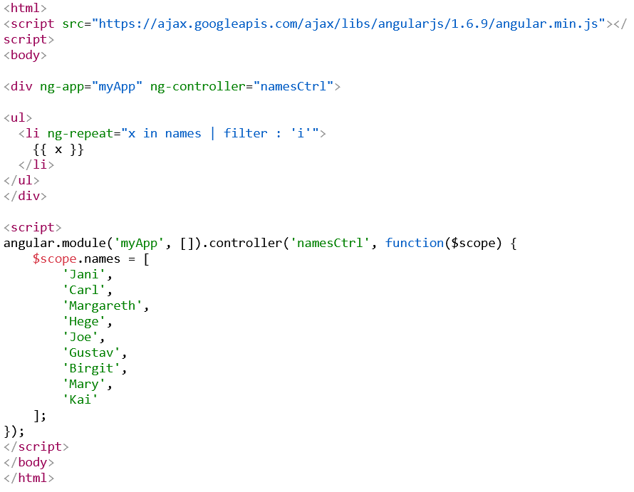
Continued…
The filter Filter
The filter filter selects a subset of an array.
The filter filter can only be used on arrays, and it returns an array containing only the matching items.

Slide 68
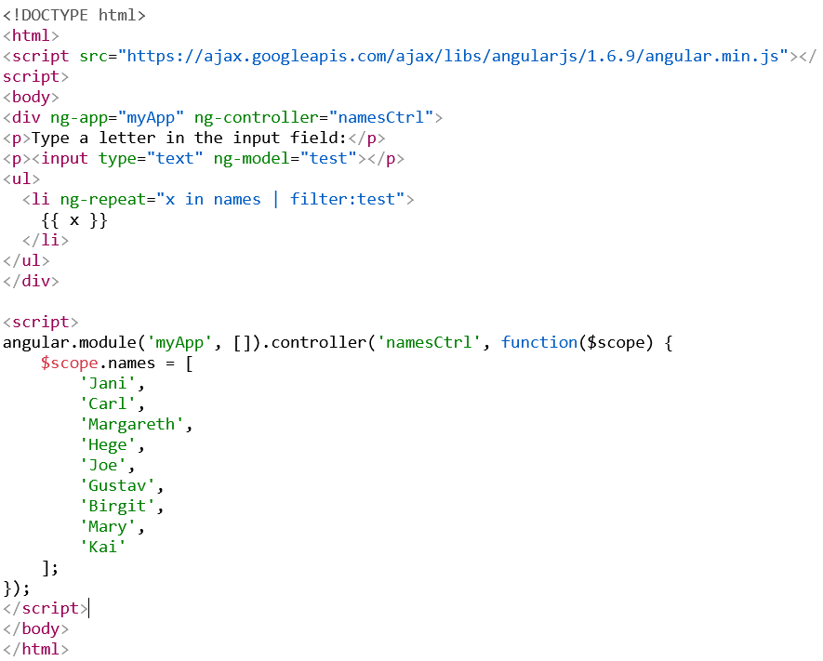
Filter an Array Based on User Input
By setting the ng-model directive on an input field, we can use the value of the input field as an expression in a filter.
Type a letter in the input field, and the list will shrink/grow depending on the match

Slide 69
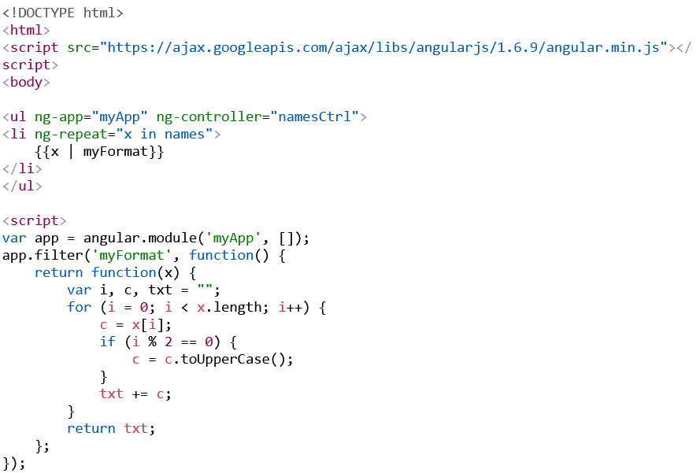
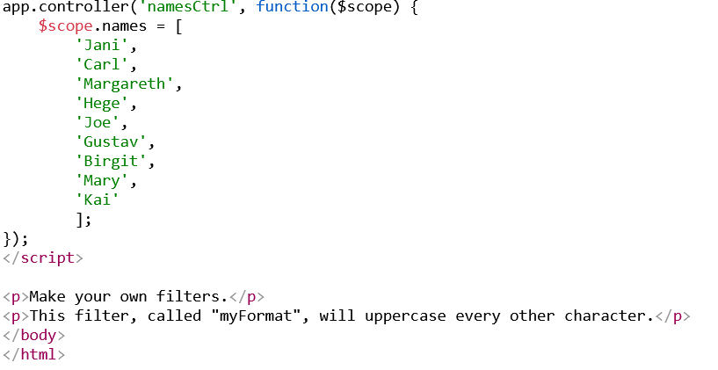
Custom Filters
You can make your own filters by registering a new filter factory function with your module

Slide 70
END

